Slide 1

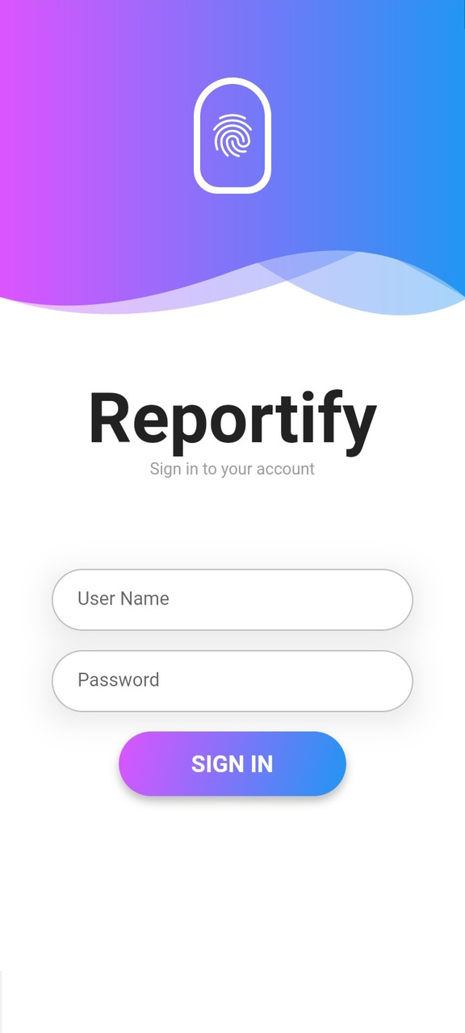
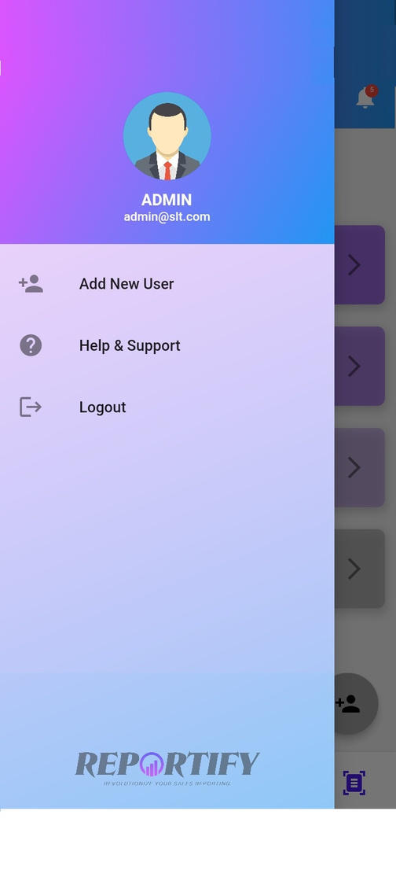
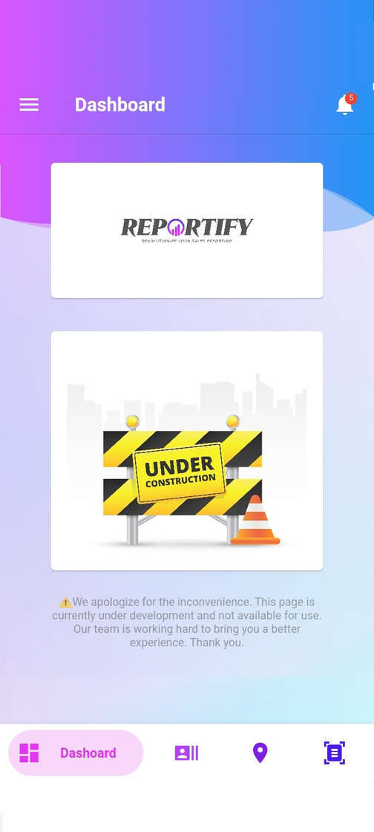
Ravindu Dharmaraja
REPORTIFY
Trainer
Revolutionize Your Sales Reporting
Reportify
How to Use

Slide 2
REPORTIFY
Revolutionize Your Sales Reporting
Content
How to Install
How to Login
Dashboard
Tabs
View Users and Add New User
View User's Records

Slide 3


REPORTIFY
How to Install
Revolutionize Your Sales Reporting
Reprtify

Slide 4


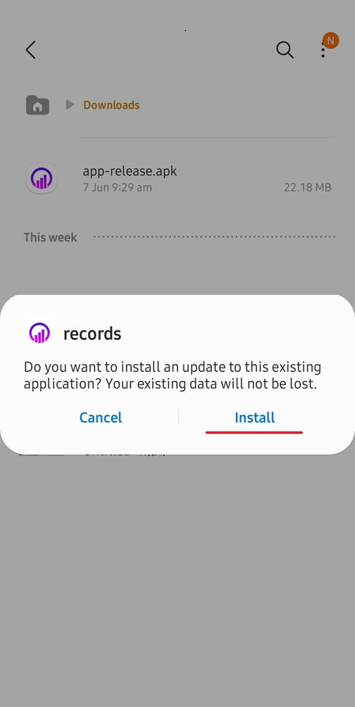
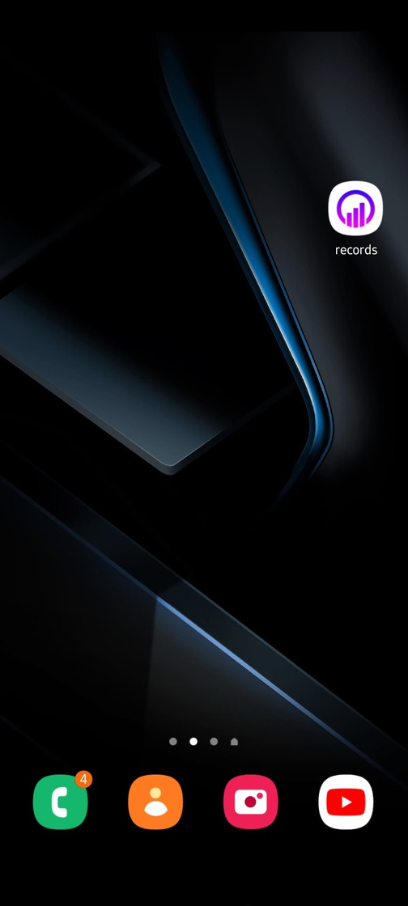
Revolutionize Your Sales Reporting
How to Install

Slide 5
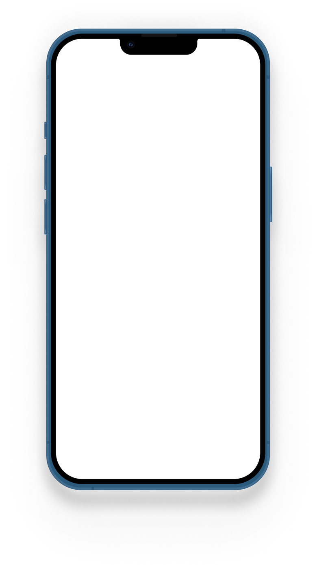
REPORTIFY
How to Login
Revolutionize Your Sales Reporting
'Notch' Product Mockups

Slide 6


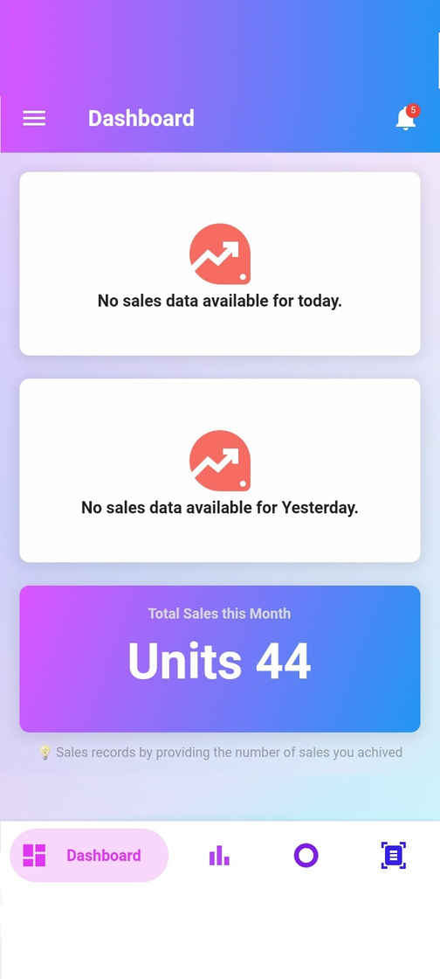
Revolutionize Your Sales Reporting
How to Login

Slide 7
Reportify
Dashboard
Features
Dashboard
Number of Users
All User Sales Total
Sales Chart
User Friendly Interface
Thos page is currently under development.
Revolutionize Your Sales Reporting
Dashboard

Slide 8

REPORTIFY
Tabs
Dashboard
Show All Sales Deatils in This Page
Black is the color of borders, and of authority. Though we have many negative associations with black, we also find it intriguing. Black absorbs all light, so it’s a low-energy color.
User Records
View All Users List
Location Tracking
Input Your Daily Sales Activities Heare
Reports
Genarate Your Sales Report Here
Revolutionize Your Sales Reporting
Tabs

Slide 9

REPORTIFY
View Users & Add New User
Revolutionize Your Sales Reporting
Reportify

Slide 10

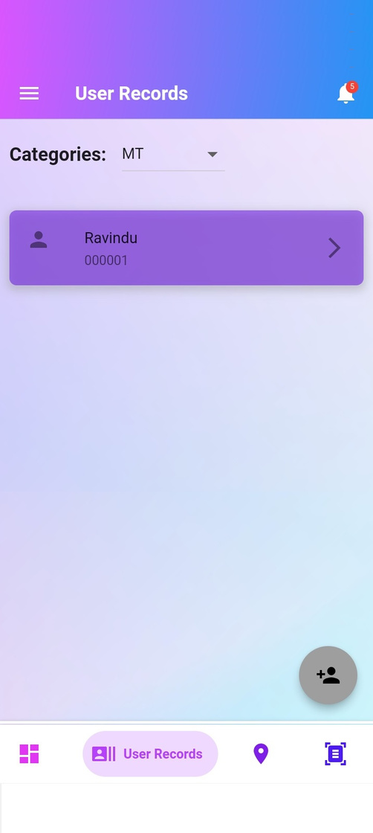
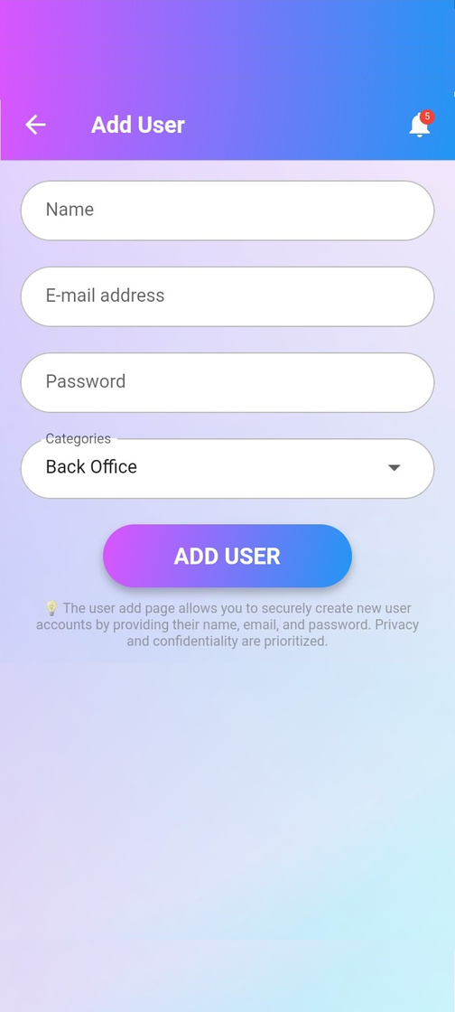
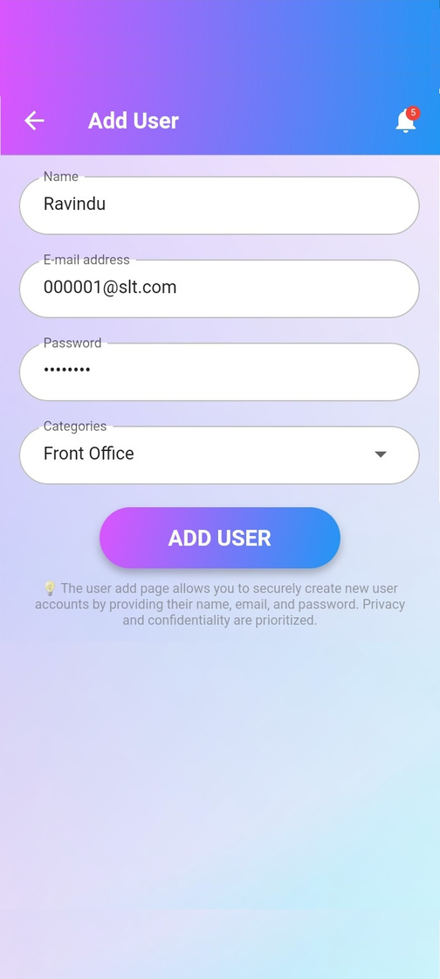
Revolutionize Your Sales Reporting
View Users & Add New User

Slide 11
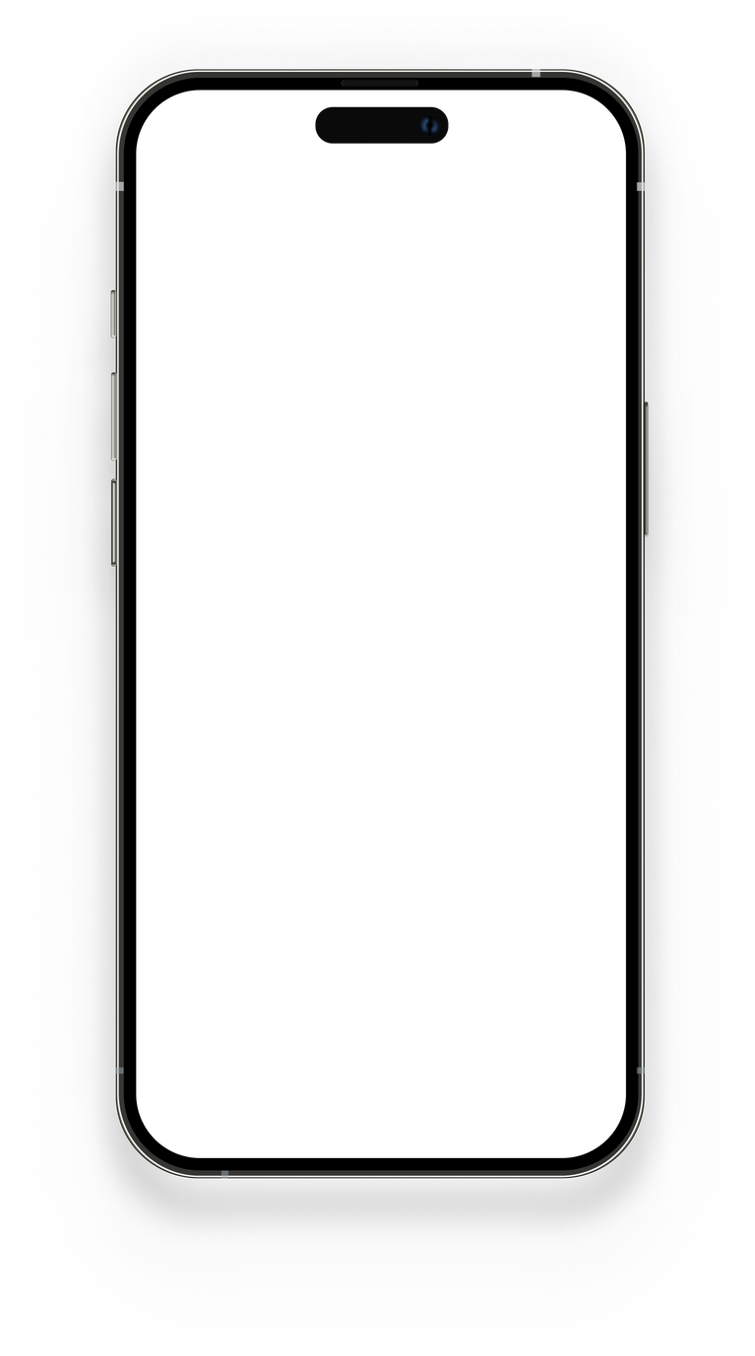
REPORTIFY
View User's Records
Revolutionize Your Sales Reporting
Reportify

Slide 12
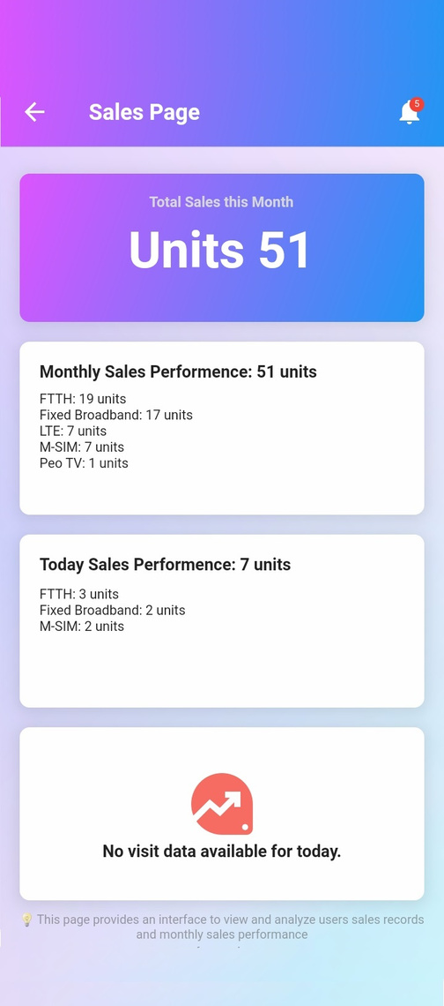
Revolutionize Your Sales Reporting
How to Import Daily Sales Activities

Slide 13
REPORTIFY
Revolutionize Your Sales Reporting
Thank You
ravindudharmaraja00@gmail.com
078 737 9991

